Slide 1
The Marriage of Moodle (and Word)
Eoin Campbell,
Kimmage Development Studies Centre,
Dublin, Ireland

Slide 2
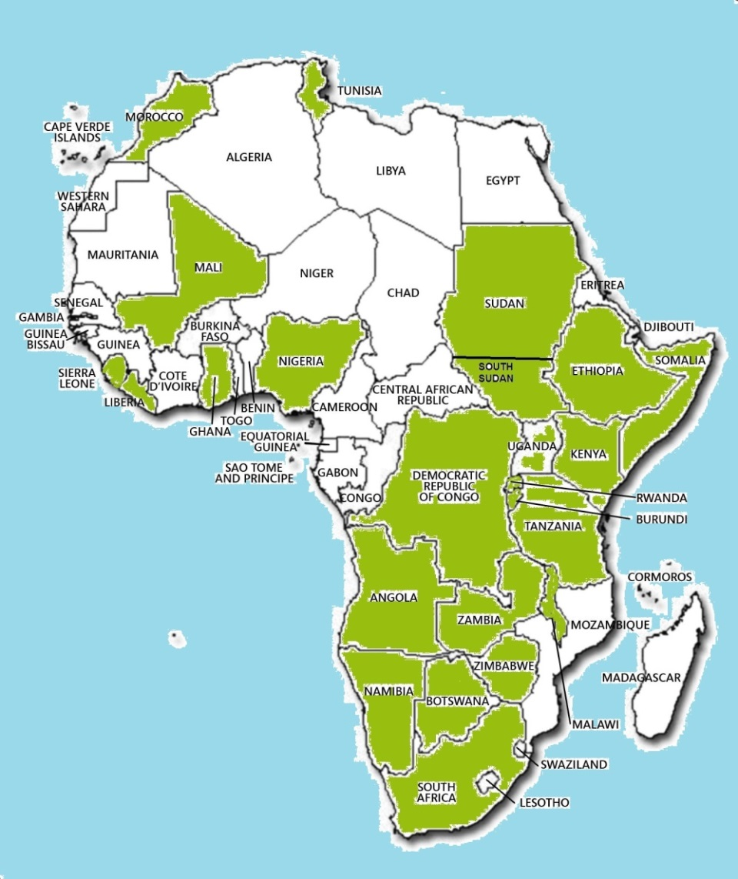
Kimmage DSC
Offers distance learning MA in International Development programme
  Also BA with Maynooth University
  CPD courses
> 50% students are located in sub-Saharan Africa
  Largely NGO or government staff
  Working in national or local offices or “in the field”
May not have “always on” access to Internet, power or even light

Slide 3
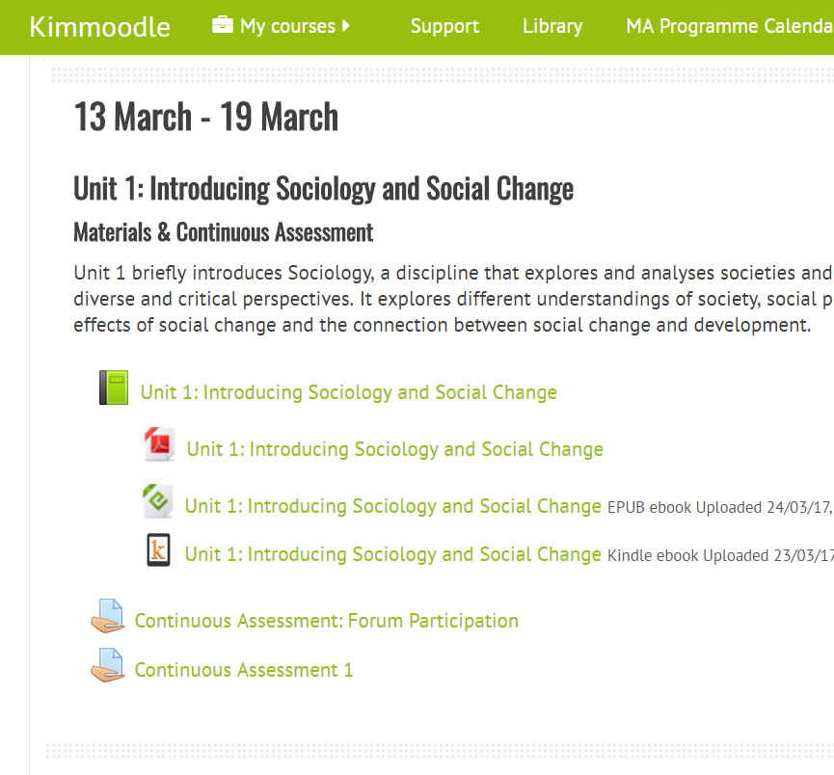
Kimmage DSC: Publishing Formats
Course material formats:
  Moodle Book (online)
  PDF for printing
  ePub ebooks for tablets/phones
  Kindle for remote workers (great batteries!)
  Even audio files for some recorded lectures

Slide 4
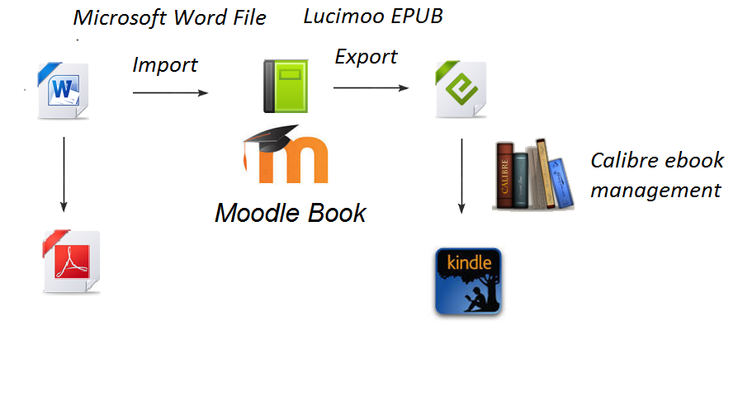
Publishing Process: Word Master File

Slide 5

Plugin: Microsoft Word File
Import/Export (Book)
Imports Microsoft Word files into Moodle
  Part of a set of plugins to support narrative text content maintenance in Word
  Supports export from Moodle to Word
  Plugins available for Books, Question banks or Pages
  Or anywhere the Atto Text Editor is used in Moodle
Notes:
5

Slide 6
Advantages of Import Word File Plugin over Copy/Paste
Automatically splits Word file into Moodle Book Chapters
Imports embedded images
Demotes headings to suit Moodle conventions
More accessible import of table headings
Supports text highlight boxes
Converts Microsoft Equations into MathML
Notes:
6

Slide 7
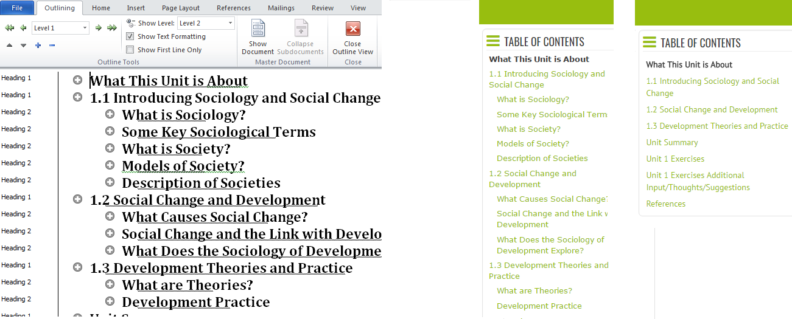
Book Import: Convert and Split
Word files are split into chapters or subchapters based on Word “Heading 1” or “Heading 2” styles

Slide 8
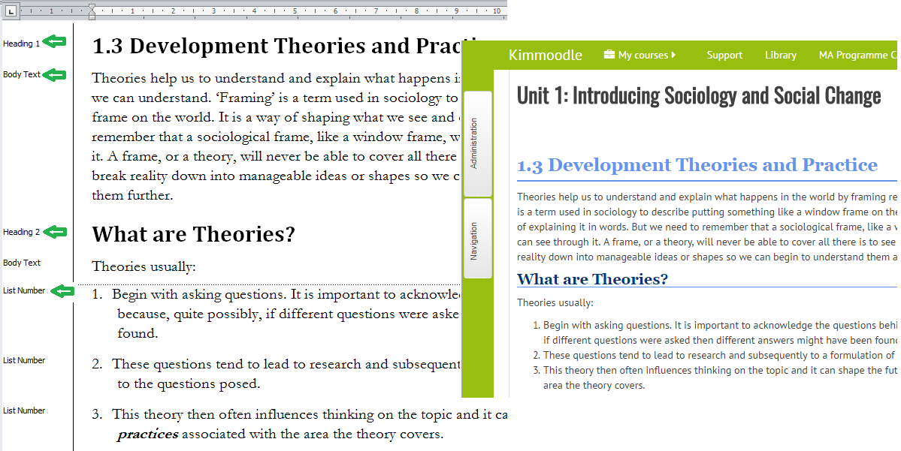
Content: Word Styles => HTML Elements
Basic principle: map Word styles into corresponding HTML elements
  Also keeps some (but not all) explicit formatting (e.g. bold)

Slide 9
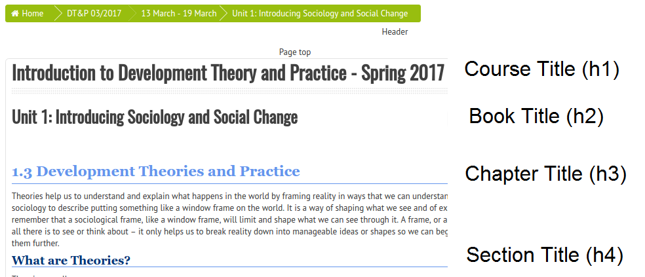
Heading Style to Element Mapping
Demotes “Heading 1” style to h3, “Heading 2” to h4, etc.
  Required to overcome Moodles’ flawed(!) heading usage convention

Slide 10
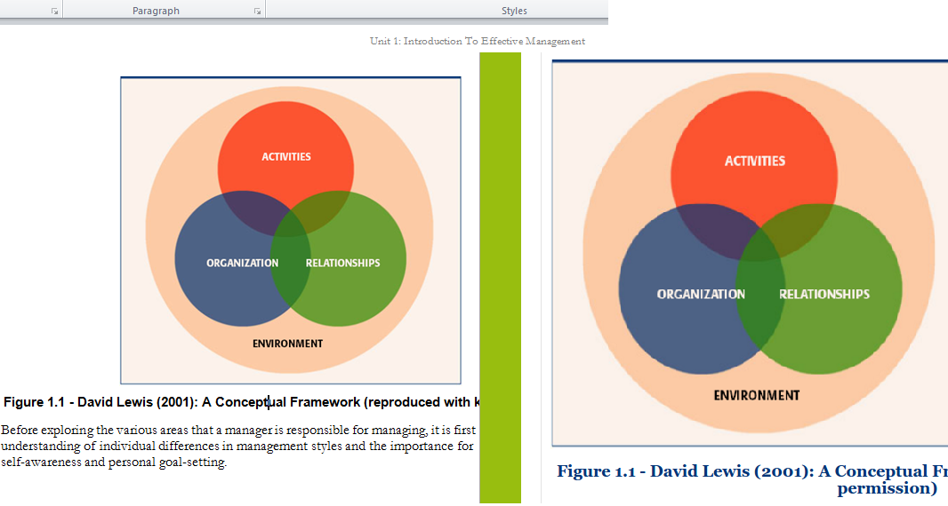
Pictures/Images
Imports and stores Web-compatible picture formats (GIF, PNG, JPG)
  Microsoft Word Shapes, SmartArt, Charts are not supported
Picture width, height and alternate text attributes are retained

Slide 11
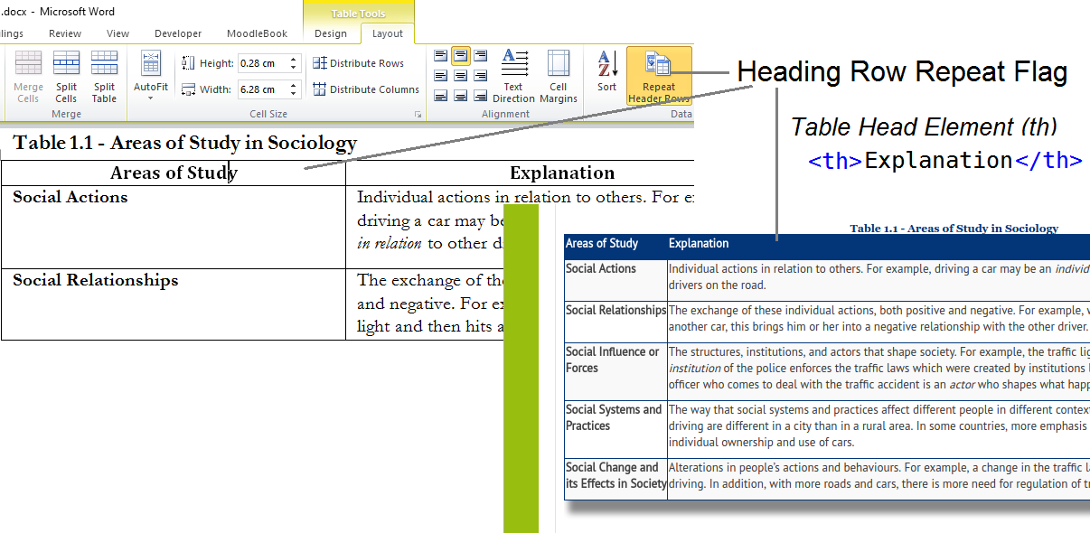
Importing Tables
Handles column and row headings, and merged/spanned cells
  Improves both accessibility and presentation quality (via CSS)

Slide 12
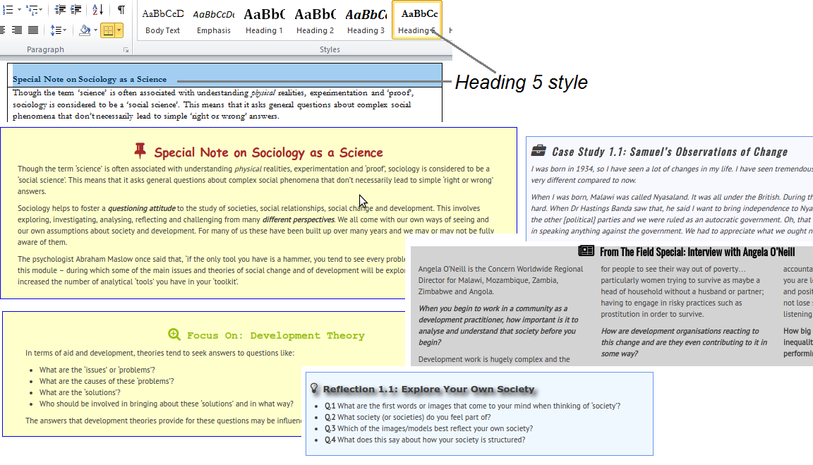
Highlight Boxes
Supports predefined highlight boxes that present nicely using CSS
  Identified in Word with Heading style 4..8 in row 1 of a 2-row, 1-column table

Slide 13
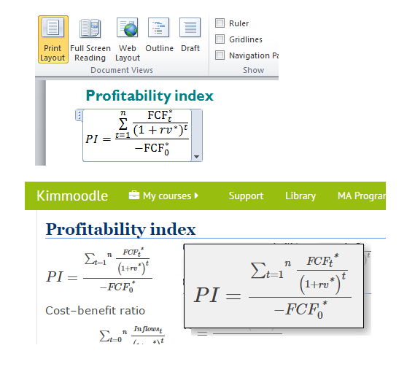
Microsoft Equation Editor to MathML
Word equations written in Office Math Markup Language (OMML)
Microsoft provide Open Source XSLT OMML to MathML conversion script
Moodle supports MathJax, Javascript-based MathML rendering engine
Plugins include OMML2MathML scripts

Slide 14
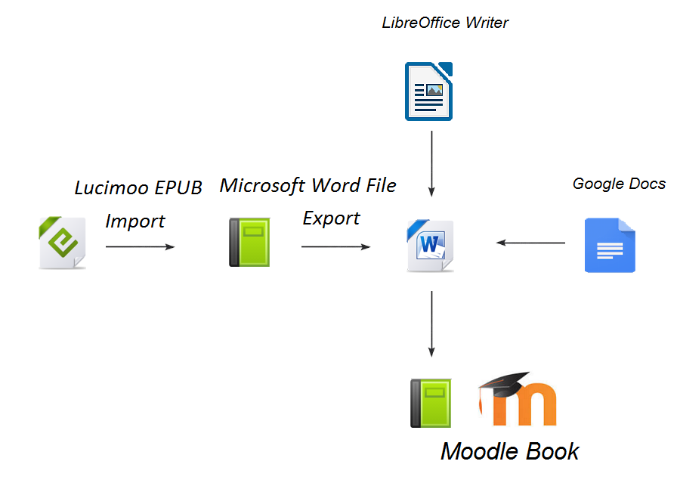
Getting Started Creating a Book
Google Docs
  Download as Word .docx file
eBook
  Import into a Moodle Book (Lucimoo) and export to Word
LibreOffice Writer
  Save as .docx file
Ideally, edit in Word
    Best for style name usage

Slide 15
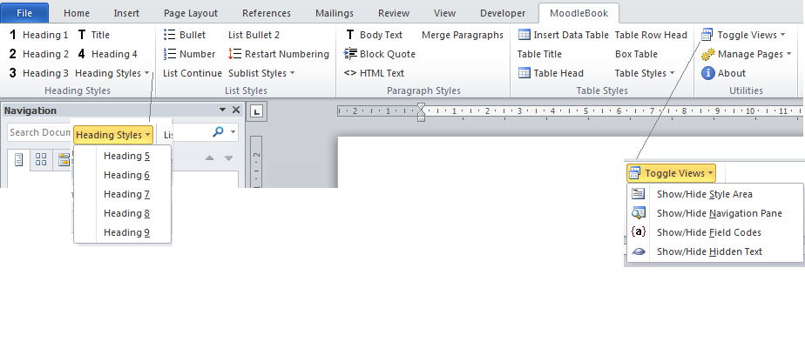
Editing: MoodleBook Word Template
Download from www.Moodle2Word.net
Gathers the most common styles in one Ribbon menu
  Styles are more explicit and easier to reach
Defines keyboard shortcuts, e.g. <Ctrl>+1 = Heading 1

Slide 16
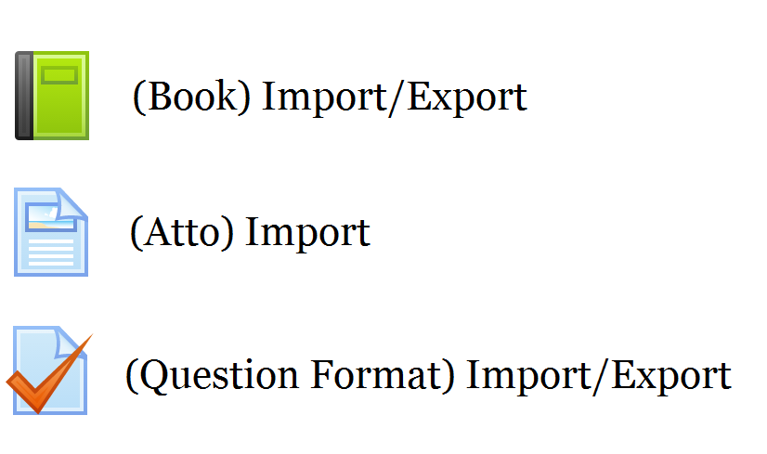
Microsoft Word File Import/Export Set

Slide 17
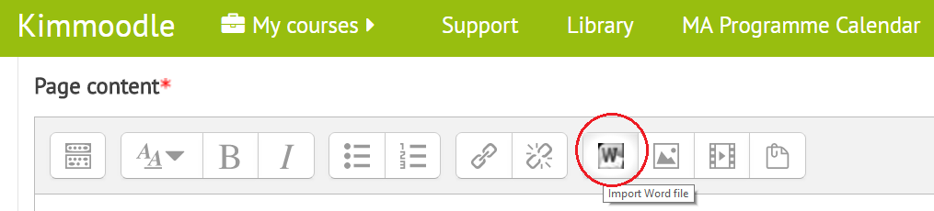
Atto Text Editor: Word File Import Plugin
Supports drag and drop Word file into text field
  See Chris Kenniburg YouTube demo http://tinyurl.com/wordimportvideo
Students could also use it for blog entries, essays, etc.

Slide 18
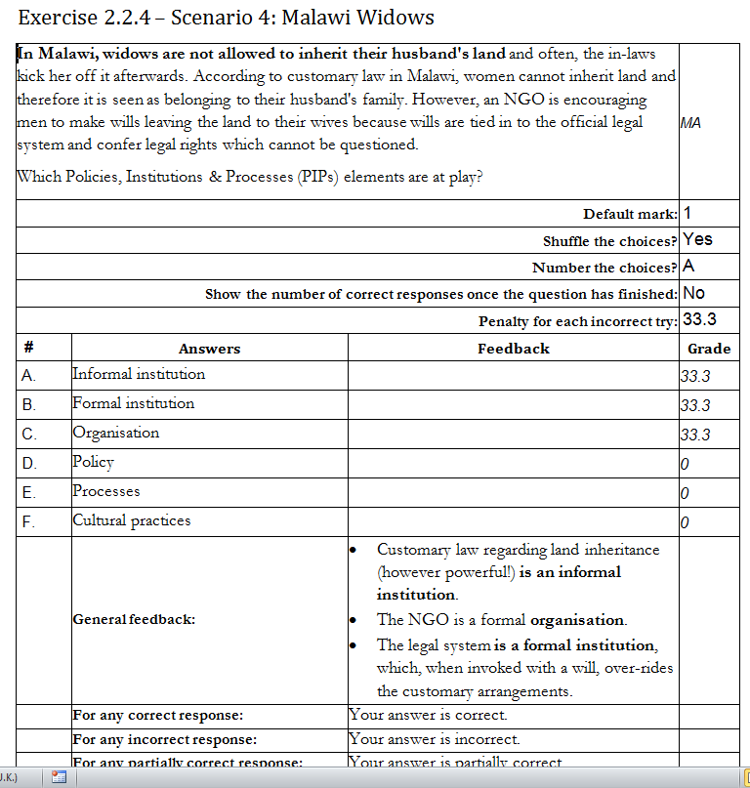
Question Format Word Import Plugin
Entire question is visible
Many questions can be managed in 1 Word file
Convenient review, printing, spell-checking, and bulk editing
Categories and questions can be easily re-organised
Offline editing is possible

Slide 19
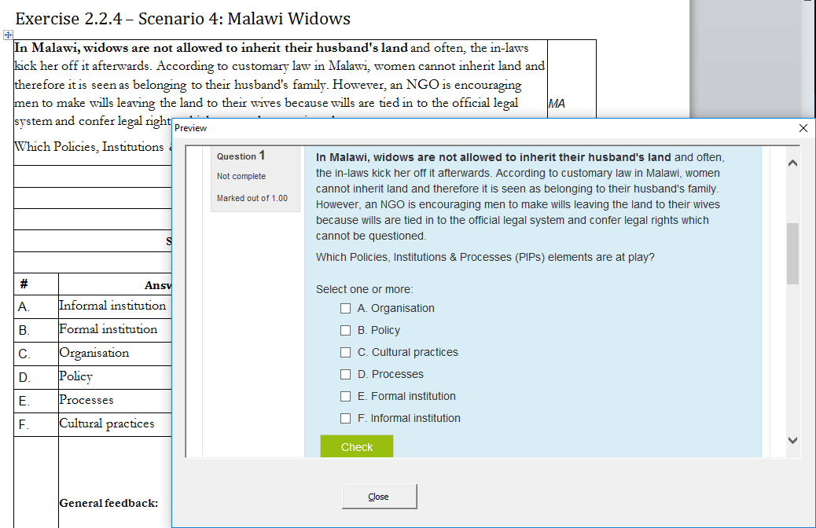
Question Preview Within Word

Slide 20
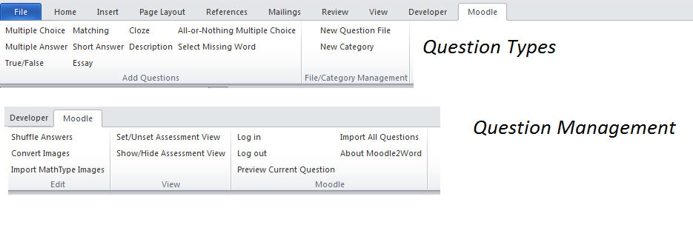
Question Format Word Template

Slide 21

Advantages of Word Editing with Import into Moodle
Familiarity
  Use a tool you already know
  Avoid HTML editing in Moodle Atto Text Editor
Convenience
  Text and images stay together
  Offline editing
Power
  Maintain multi-page books in a single file
  Maintain many multi-field questions in a single file

